Slide 1

IronHack Payments
Vinicius J. Jodar
Chaitanya Diwakar
P. Katherine Torian

Slide 2

Introduction
Dataset combines cash requests and fee data from IronHack Payments.
Goal: Understand user behavior over time using cohort analysis.

Slide 3
Cohorts
Topics:
Created monthly cohorts using ‘send_at’.
Grouped by cohort and transaction type to find usage trends.

Slide 4
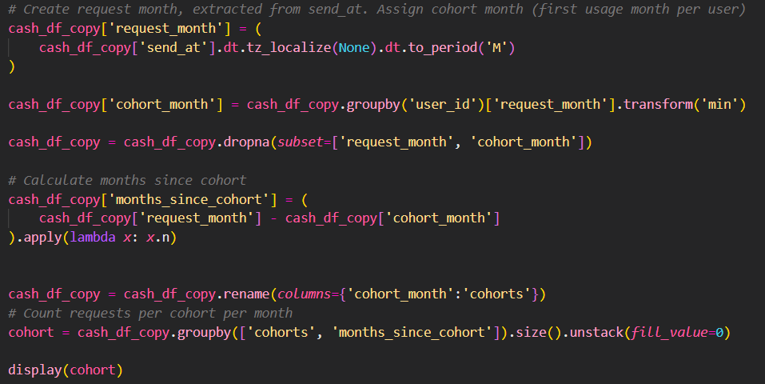
Frequency of Service Usage
We grouped users by the month they first used the service (cohorts) and tracked how often they requested cash advances over time. This shows how engaged each cohort is after onboarding.

Slide 5
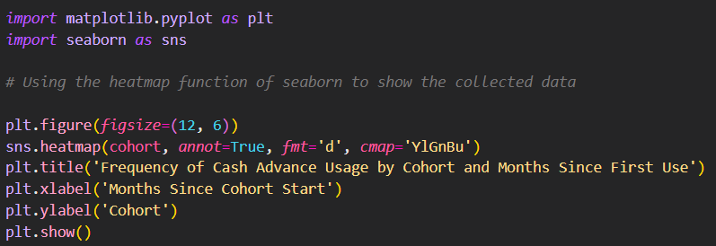
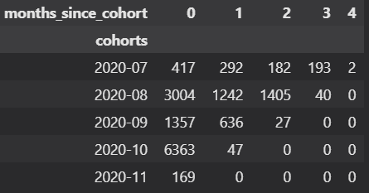
Frequency of Service Usage
Why it matters…
It helps IronHack Payments see which users keep using the service and when others drop off — key for improving retention and planning better user strategies.

Slide 6
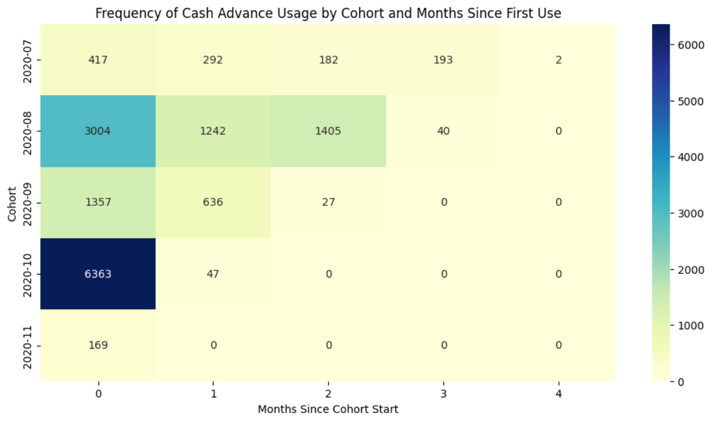

Slide 7
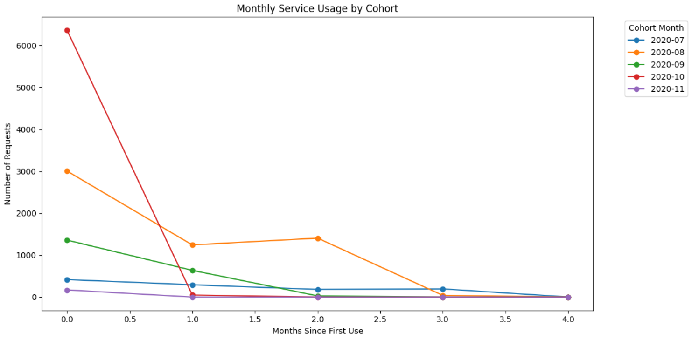

Slide 8
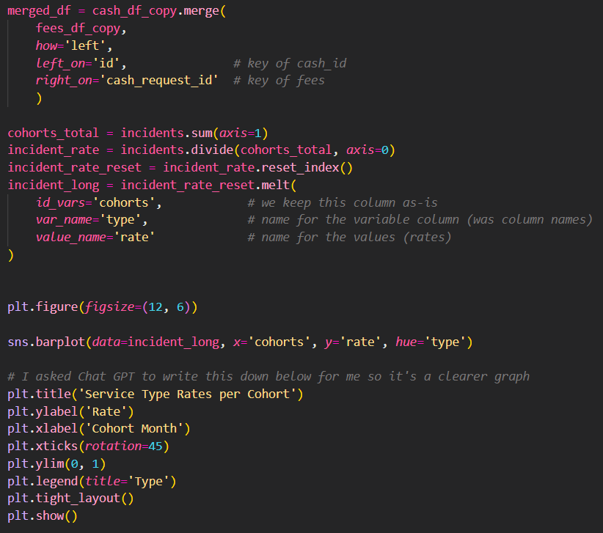
Incident rate
We measured how often payment-related incidents occurred within each user cohort by calculating the proportion of requests that had incidents (grouped by type). This tells us how incident-prone each cohort is over time.

Slide 9
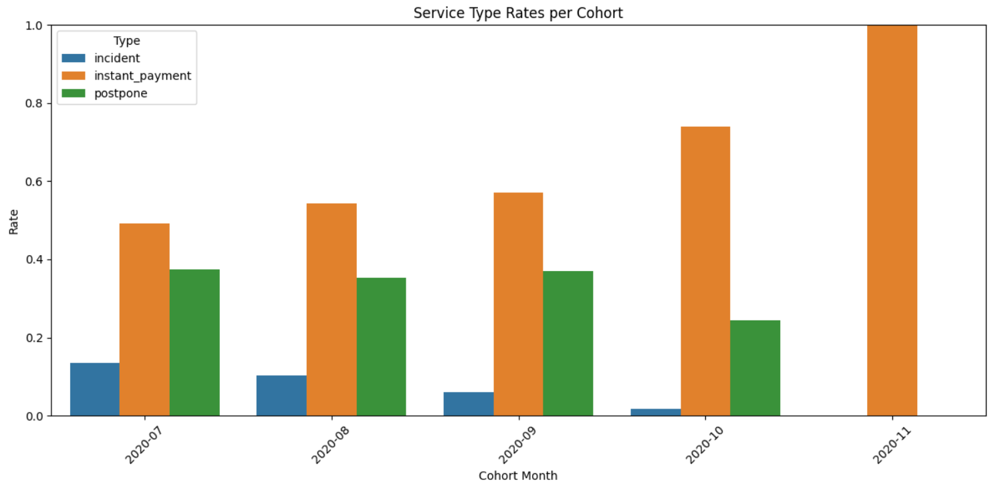
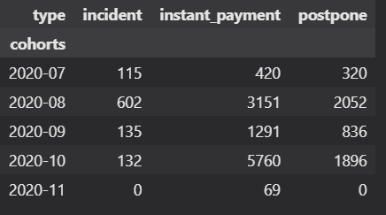
Incident rate
Why it matters…
It helps IronHack Payments spot patterns in user issues, identify high-risk cohorts, and improve their services by reducing the most frequent incident types.

Slide 10
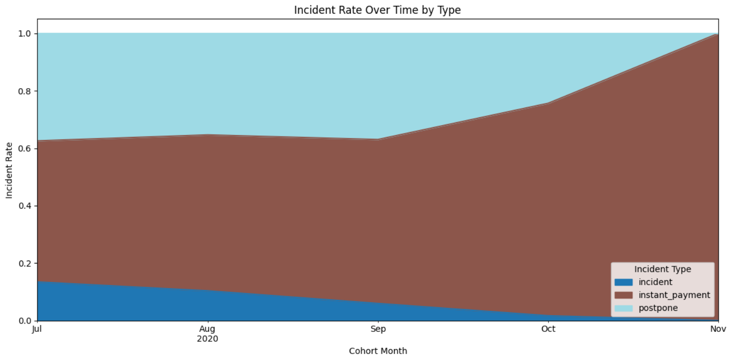
Incident rate

Slide 11
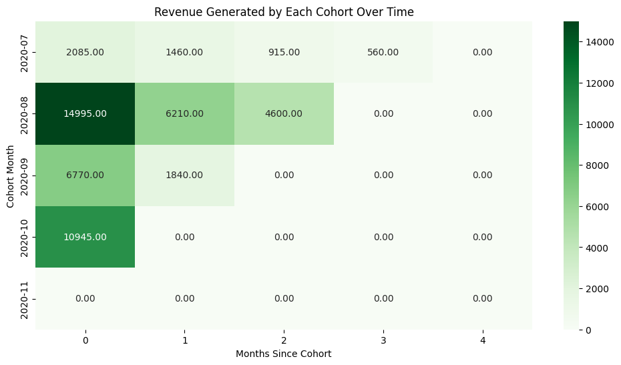
Revenue Generated by Cohort
This heatmap shows the revenue generated by each user cohort over time:
Rows represent different cohorts, defined by the month when users made their first cash advance (e.g., 2020-07, 2020-08, etc.).
Columns represent the number of months since each cohort started (0 = first month, 1 = second month, etc.).
Cell values show the total revenue (sum of fees or amounts) generated by that cohort in that month since joining.

Slide 12
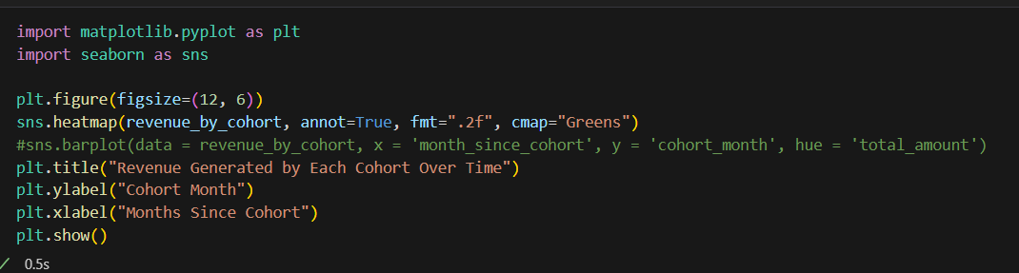
Explanation
This code visualizes how much revenue each cohort of users generates in each month after joining. It helps us quickly see which cohorts are most valuable and how revenue trends change over time."

Slide 13
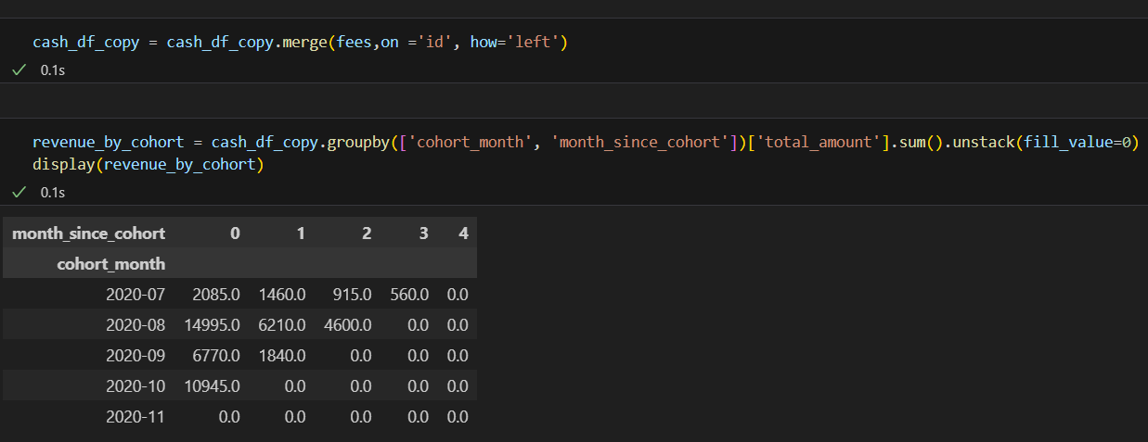
Revenue generated

Slide 14
Project Summary: Cohort Analysis for Ironhack Payments
Objective:
To understand user behavior and business performance by analyzing how different groups of users (cohorts) interact with Ironhack Payments over time.
Approach:
We grouped users into cohorts based on the month of their first cash advance. For each cohort, we tracked key metrics such as service usage frequency, payment incident rates, and revenue generated over subsequent months.

Slide 15
Continued….
Key Findings:
Most revenue is generated in the first month after users join, with a noticeable drop in following months.
Some cohorts contribute significantly more revenue than others, highlighting periods of strong user acquisition or engagement.
Incident rates and usage patterns can be compared across cohorts to identify trends and areas for improvement.
Business Value:
This analysis helps Ironhack Payments identify which user groups are most valuable, understand retention and engagement trends, and make data-driven decisions to improve customer experience and revenue growth.

Slide 16

The End

